Slide 1
Experiment one
Specific heat capacity of liquid by an electrical heating method
Aim: To measure the specific heat capacity of water using electric method.

Slide 2
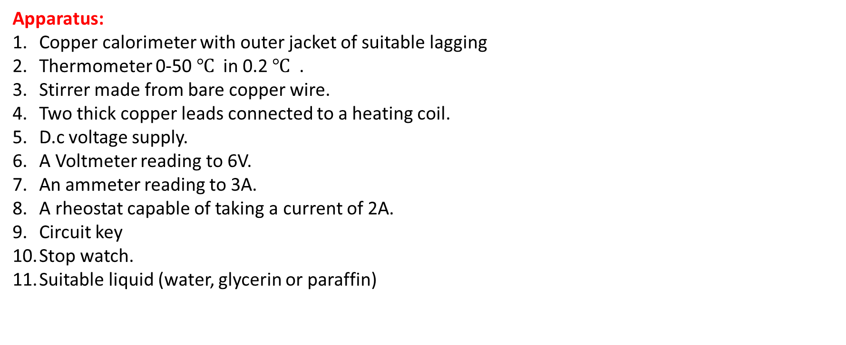
Apparatus:
Copper calorimeter with outer jacket of suitable lagging
Thermometer 0-50 $℃$ in 0.2 $℃$ .
Stirrer made from bare copper wire.
Two thick copper leads connected to a heating coil.
D.c voltage supply.
A Voltmeter reading to 6V.
An ammeter reading to 3A.
A rheostat capable of taking a current of 2A.
Circuit key
Stop watch.
Suitable liquid (water, glycerin or paraffin)

Slide 3
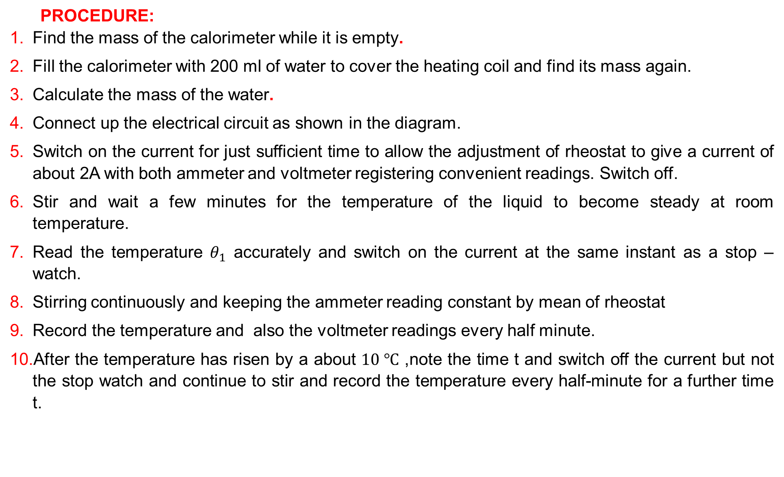
PROCEDURE:
Find the mass of the calorimeter while it is empty.
Fill the calorimeter with 200 ml of water to cover the heating coil and find its mass again.
Calculate the mass of the water.
Connect up the electrical circuit as shown in the diagram.
Switch on the current for just sufficient time to allow the adjustment of rheostat to give a current of about 2A with both ammeter and voltmeter registering convenient readings. Switch off.
Stir and wait a few minutes for the temperature of the liquid to become steady at room temperature.
Read the temperature $θ_{1}$ accurately and switch on the current at the same instant as a stop –watch.
Stirring continuously and keeping the ammeter reading constant by mean of rheostat
Record the temperature and also the voltmeter readings every half minute.
After the temperature has risen by a about $10 ℃$ ,note the time t and switch off the current but not the stop watch and continue to stir and record the temperature every half-minute for a further time t.

